Slide 1
Summer Research: The Tennis Ball Problem

Slide 2
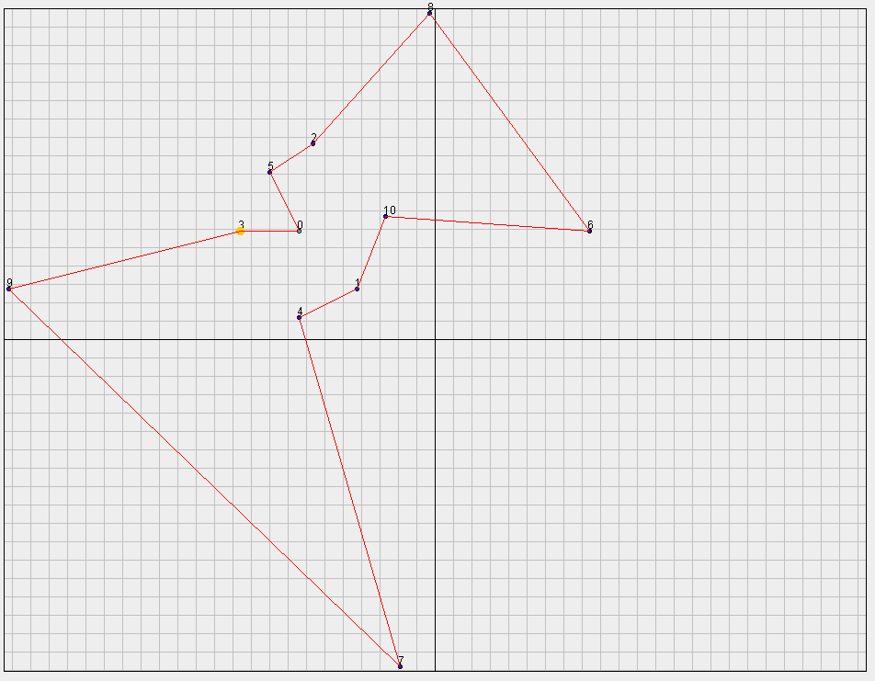
The Traveling Salesman Problem
O(N!) to solve through brute force methods.
Find the tour which minimizes the distance traveled.
A tour must visit each point once and end at the beginning point.
Solved using heuristics and approximation algorithms.

Slide 3
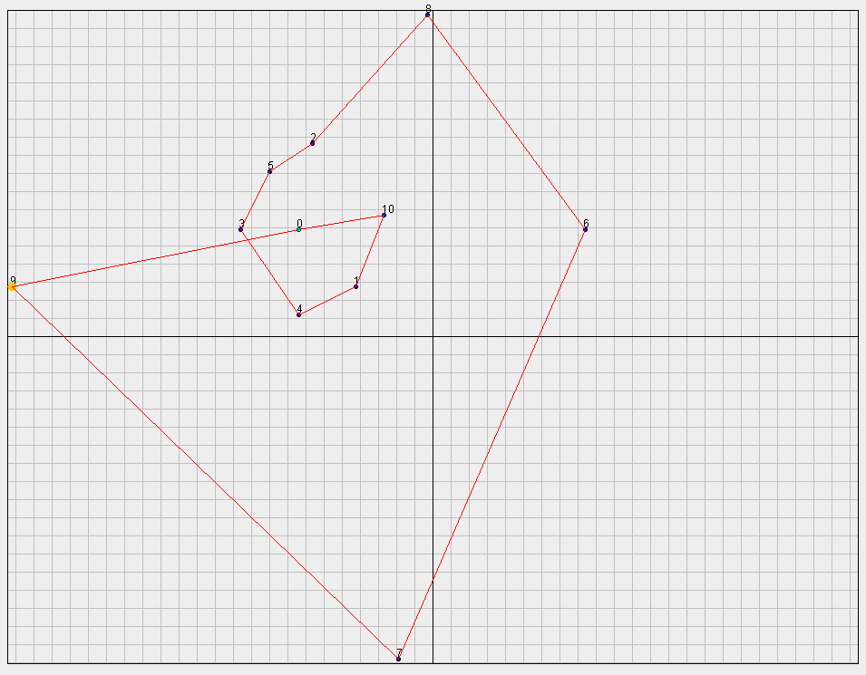
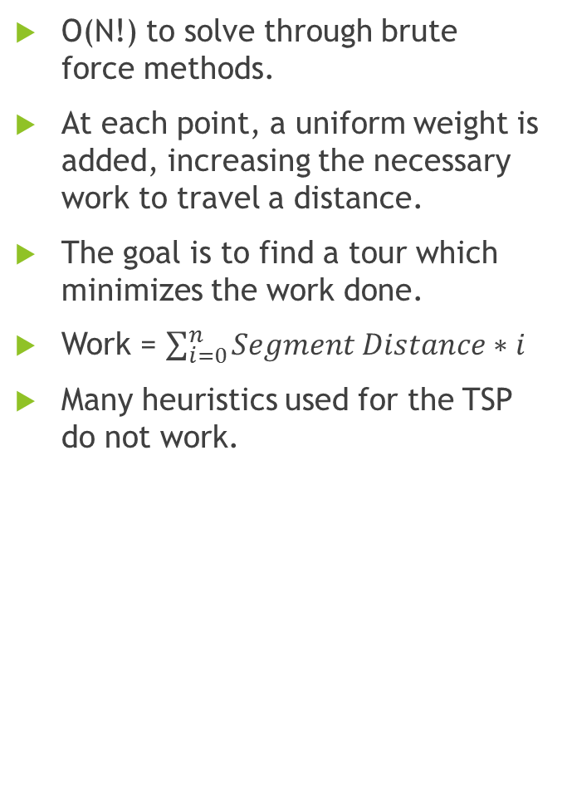
The Tennis Ball Variation
O(N!) to solve through brute force methods.
At each point, a uniform weight is added, increasing the necessary work to travel a distance.
The goal is to find a tour which minimizes the work done.
Work = $\sum_{i=0}^{n}{Segment Distance}∗i$
Many heuristics used for the TSP do not work.
Tour | TSP Optimal | TBP Optimal
Distance | 14559 | 15244
Work | 74478 | 59970

Slide 4
Brute Force vs. Approximation
Larger city sets are not computationally feasible using brute force searches.
We created an algorithm which approximated a TBP solution in O(N³).
N | N! | N^3
5 | 120 | 125
6 | 720 | 216
7 | 5040 | 343
8 | 40320 | 512
9 | 362880 | 729
10 | 3628800 | 1000
15 | 1.31 * 10^12 | 3375

Slide 5
Our Algorithm: Clustering
The goal of our algorithm is to cluster cities into groups of less than ten. Therefore the best route through this sub group can be found through a brute force search.
Our algorithm creates a tree in which every node is a cluster has ten children. Nodes are leaves when they contain less than 10 cities within them.
Our algorithm breaks down a map of cities into 10 clusters; each of those clusters is broken into 10 more clusters and recursively continues until all clusters are below the cutoff point.
K-Mean Cluster
Uses 3-Dimensional clustering based on x position, y position, and distance from other points.
Combines nearest cities into clusters to create 10 original clusters.
Cities are reassigned to nearest cluster centroid until no reassigns are necessary.

Slide 6
Pathing
During pathing, each cluster is treated as a city based on the mean of its contents’ x and y positions.
Each layer of clusters can then be treated as its own variable weight TBP where the weight of clusters is a function of the number of cities and spread.
The best tour is found using brute force searches in each layer of clusters.
The pathing algorithm assigns numeric values to each node in the tree and its children.
A function then uses these values to create a final tour.
Optimization
The final tour is optimized using two methods: 2-Opt and Insert-Opt.
2-Opt switches the order of nearby cities to mitigate small mistakes made by the algorithm.
Insert-Opt attempts to insert outliers into different positions in the tour.

Slide 7
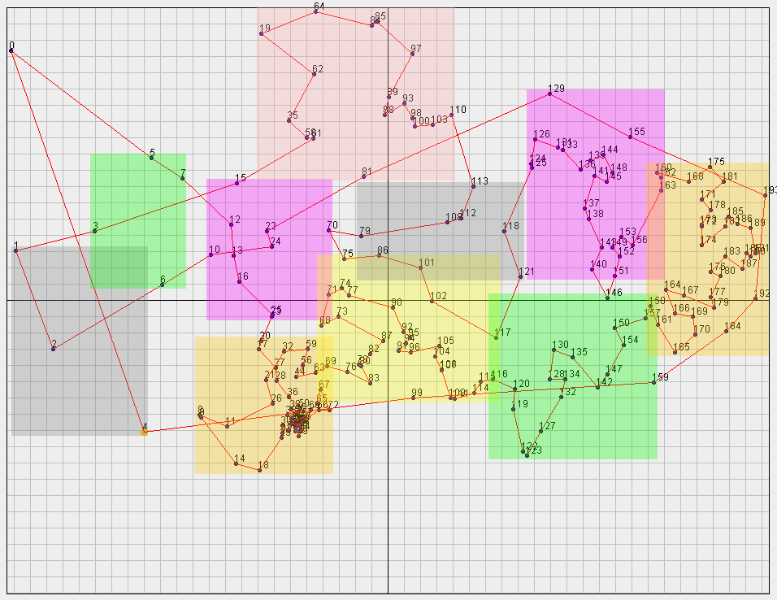
Qatar 194 City Result
Top level clusters are shown by the colored boxes.
Algorithm ran in 1.663 seconds.
The brute force algorithm would take over 7.3E306 steps to complete.
The resulting tour requires 766,119 units of work to complete. The resulting tour is 26% better than the optimal TSP tour.

